Slide 1
GDFA PROJ – 2 CS 738
Sandeep Dasgupta
Y9111031

Slide 2
Goal 1
Extend GDFA Architecture to Non-separable Framwork.
To extend the bitvector framework where the dataflow information can be represented using bit vector but the frameworks are non-separable.
Implementing of faint variable analysis, possibly uninitialised variable analysis using the extended framework.
The existing bit vector analysis should work fine with the extended framework.

Slide 3
Goal 2
Output should be in
Textual format – print GIMPLE code lines showing impact chains.
Graphical format – Highlight the impact chains.

Slide 4
Some Concepts
Bit vector framework
Independence of data flow information of different entities.
f_{n}(X) = (X − Kill_{n}) ∪ Gen_{n}
Non Separable Framewok
Data flow value of a given entity may depend on the data flow value of same entity or data flow value of some other entity.
Gen_{n}(x) = ConstGen_{n} U DepGen_{n} (x)
Kill_{n}(x) = ConstKill_{n} U DepKill_{n} (x)
f_{n}(X) = (X − Kill_{n}(x)) ∪ Gen_{n}(x)

Slide 5
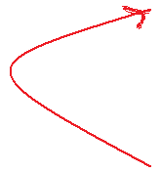
Transitive Effects : Impact Chains
ENTRY
ENTRY
ENTRY
B = 2;
B = 2;
A = 3;
B = 2;
A = 3;
‘B’ live, ‘A’ not
A = B + 1;
A = B + 1;
Transitive Effect
‘B’ not live
‘A’ not live
Use(A)
EXIT
EXIT
EXIT
Live Variable Analysis : Before Dead Code Elimination
Live Variable Analysis : After Dead Code Elimination
Notes:
<number>

Slide 6
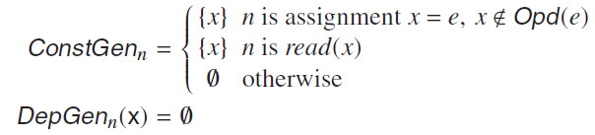
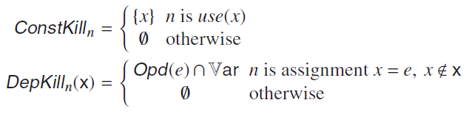
Faint Variable Analysis
A variable x ∈ Var is faint at a program point u if along every path from u to End, it is either not used before being defined or is used to define a faint variable.
IN = (a)
a = b + c;
DepKill(X) = (b,c)
X = (b, c)

Slide 7
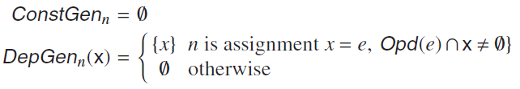
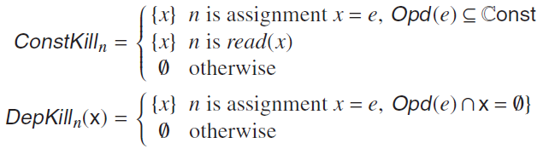
Possibly Uninitialized Variable Analysis
A variable x ∈ Var is possibly uninitialized at a program point u if there exists a path from Start to u along which either no definition of the variable has been encountered or the definition uses a possibly uninitializedvariable on the right hand side of the assignment.
IN = (b)
a = b + c;
DepGen = (a)
OUT = (a, b)

Slide 8
Challenges
Basic blocks for non-separable analyses consist of single statements
Local dfa : Calculate Const Gen and Const Kill of each statement.
Global dfa :
Stmt_1
Stmt_2
IN(Stmt_1) = (IN(Stmt_2) - KILL(Stmt_1)) U GEN(Stmt_1)
IN(Stmt_2) = (OUT(B) - KILL(Stmt_2)) U GEN(Stmt_2)
OUT(Stmt_2) = OUT(B)
OUT(B)
GEN(Stmt_1) = ConstGen(Stmt_1) U DepGen _{Stmt_1}(IN(Stmt_2))
KILL(Stmt_1) = ConstKill(Stmt_1) U DepKill _{Stmt_1}(IN(Stmt_2))
GEN(Stmt_2) = ConstGen(Stmt_2) U DepGen _{Stmt_2}((OUT(B))
KILL(Stmt_2) = ConstKill(Stmt_2) U DepKill _{Stmt_2}((OUT(B))

Slide 9
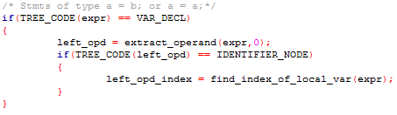
Challenges
To include some other statement types in the analysis domain.
Copy statements :
Indexing the statements keeping intact the indexing for reaching definition analysis.
Operand extraction from Scanf & Printf not yet done.

Slide 10
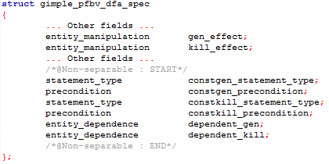
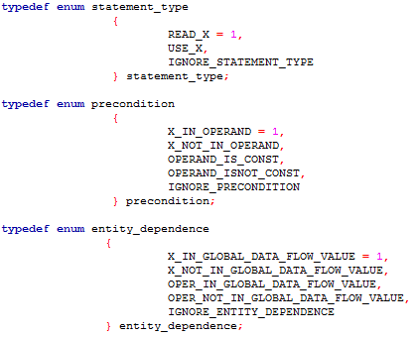

Slide 11
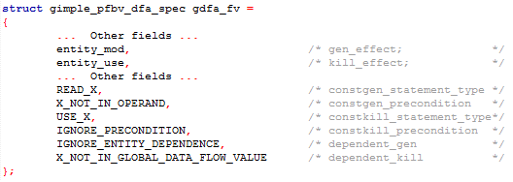
Specification Structure For Faint Variable Analysis

Slide 12
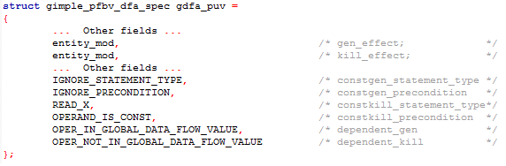
Specification Structure For UnInitialized Variable Analysis

Slide 13
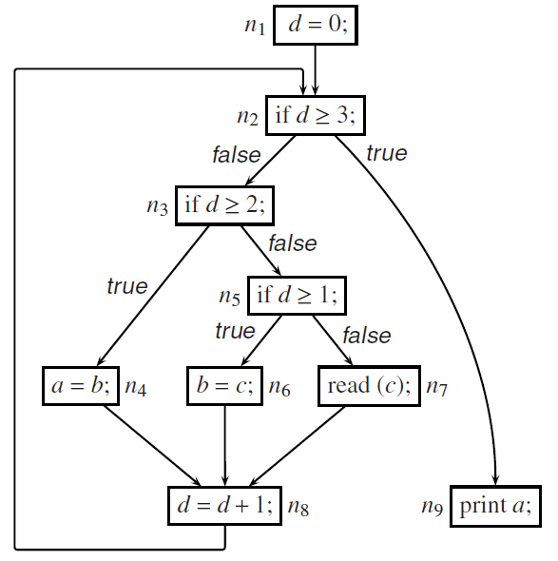
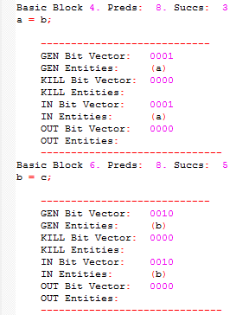
Results 1 : Textual Format

Slide 14
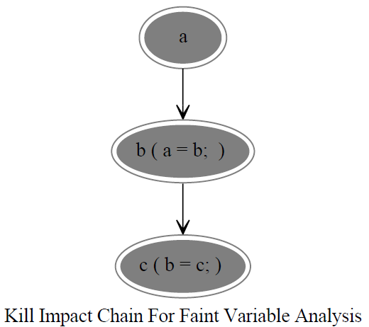
Results 1: Graphical Format
Using Dot tool of GrapghViz Software

Slide 15
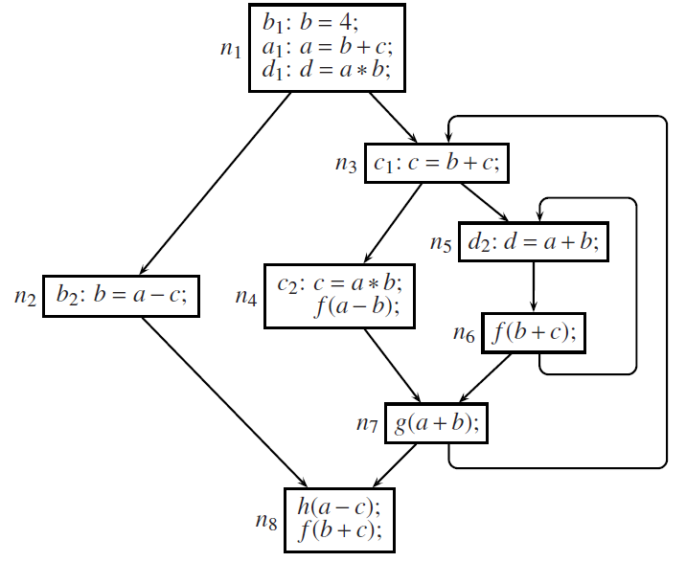
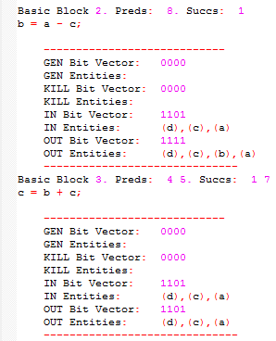
Results 2 : Textual Format

Slide 16
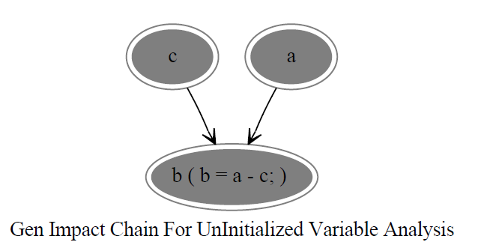
Results 2: Graphical Format
Using Dot tool of GrapghViz Software

Slide 17
THANK YOU

